Slide 1
RAJar

Slide 2
rajar
Radio Joint Audience Research Limited
RAJAR measures radio audiences in the UK
It is in partnership with the BBC and the Radiocentre on behalf of the commercial sector
RAJAR surveys over 300 individual stations that broadcast in the UK, 55 of these are owned by the BBC.
An example of this is that they survey small and large areas, the smallest being an area with 50,000 adults
48.4 millions adults 15+ listened in the last quarter of 2018
3 in 5 listen digitally

Slide 3
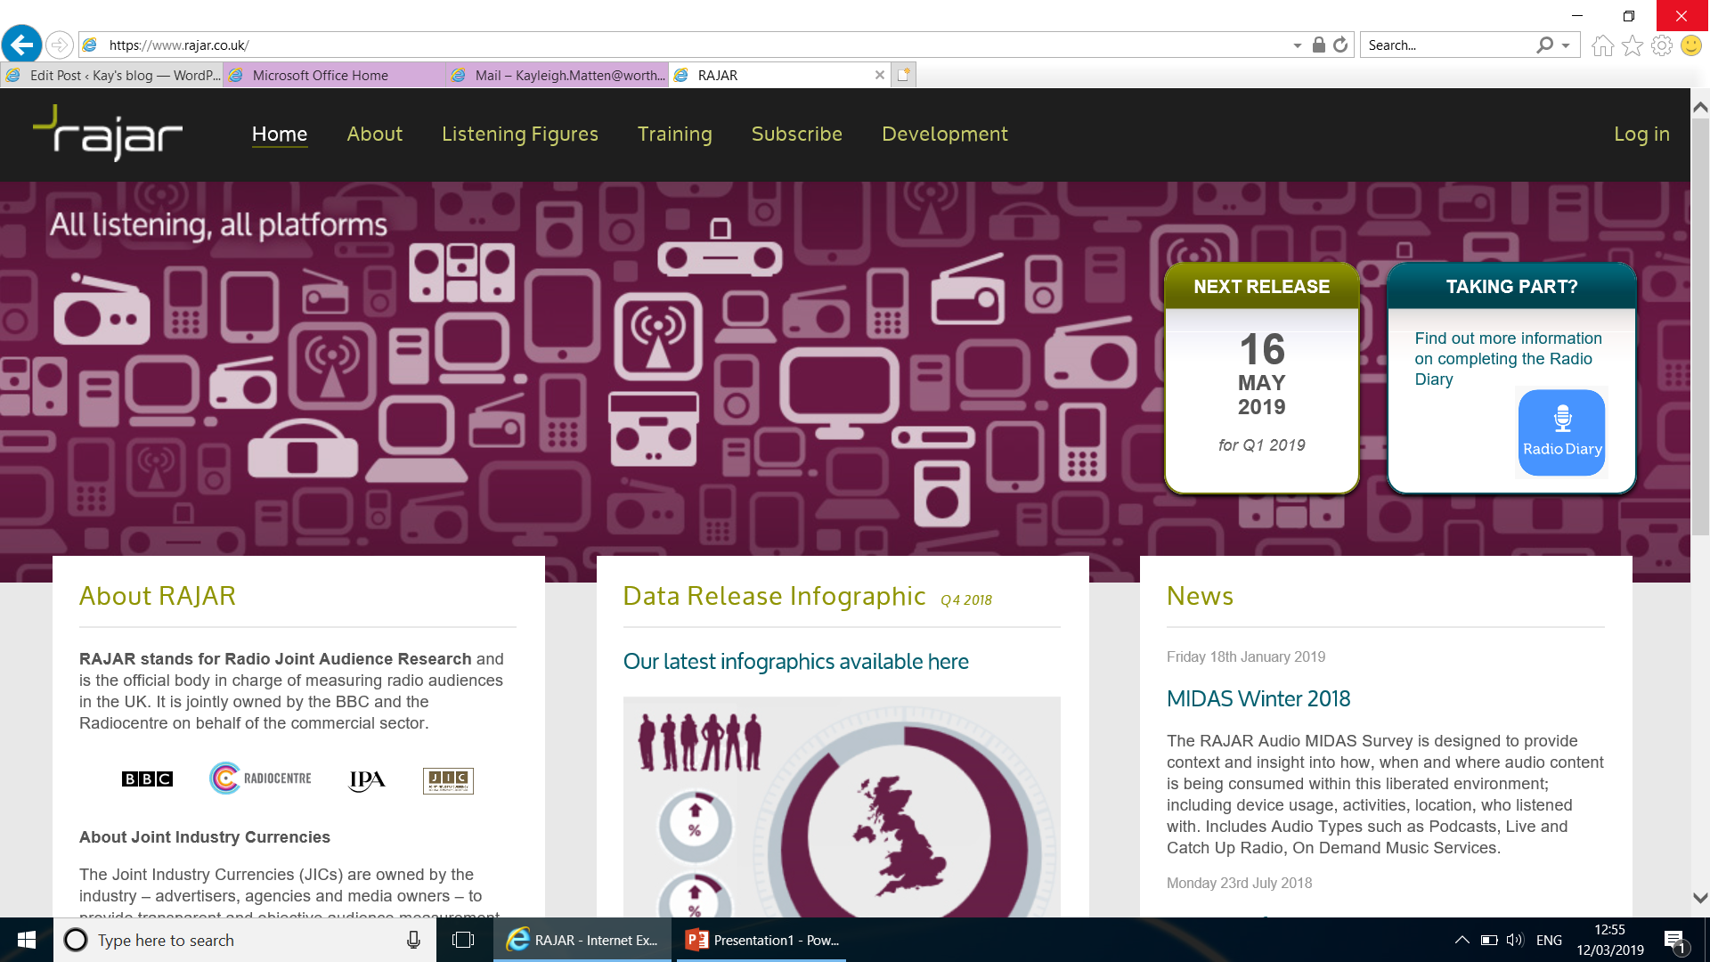
RAJAR

