Slide 1
RAJAR
By Liam Grange and Connor Smith

Slide 2
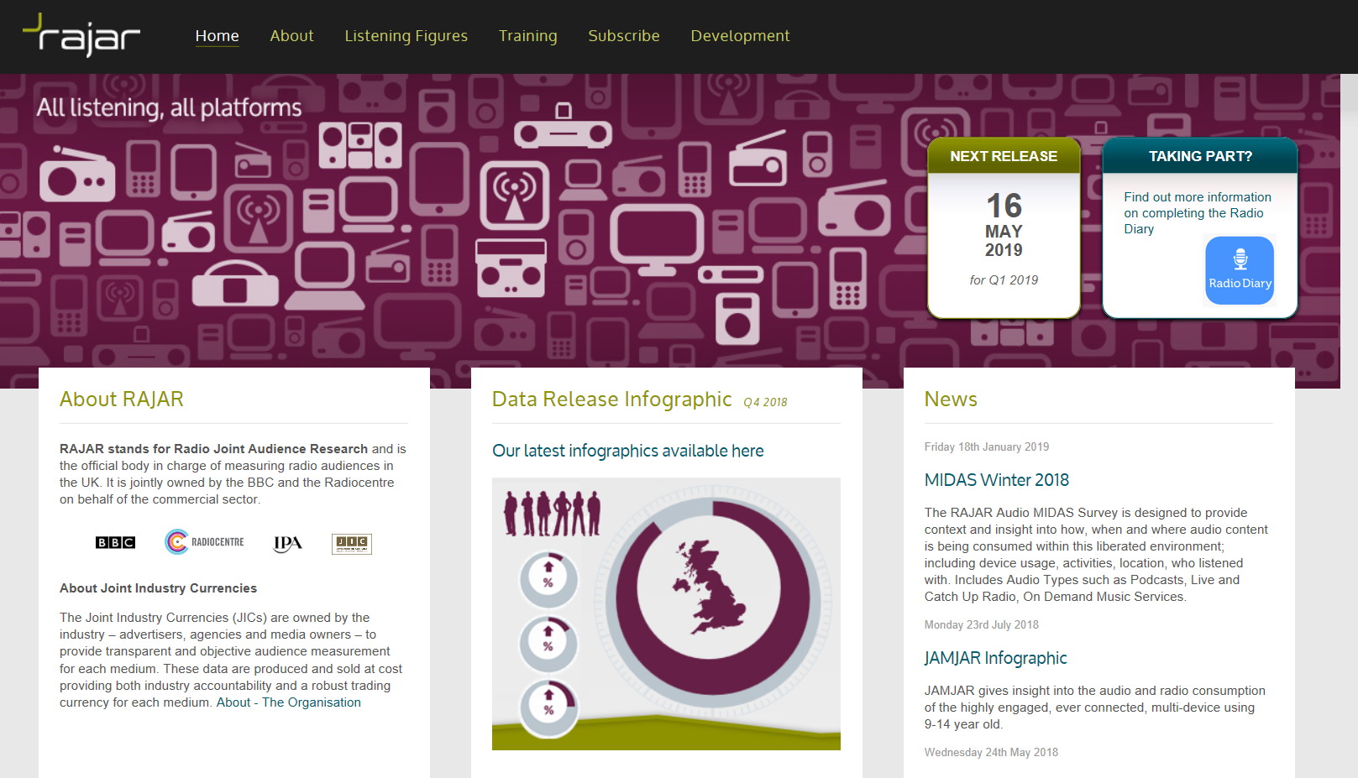

Slide 3
What the acronym stands for
RAJAR- Radio Joint Audience Research

Slide 4
Providing Audience Research
RAJAR collects its information on behalf of over 300 radio stations of small and large, commercial licensed stations by BBC and Ofcom. They collected information of time, duration, platform and location. This information is collected and published o a quarterly basis.

Slide 5
How Research is conducted
(How, demographic and provision)
The research methodology is based on continuous diary survey, measuring listening behavior of over 54,000 adults a year (aged +15). Its documented on a quarter-hour basis for a week listening, which is taken from a sample representative of a single area of transmission, alongside the nation as a whole.
The research is actually carried out on behalf of RAJAR by special research contractors, which at the time of writing this, is 'Ipsos Mori'

Slide 6
The most popular products
RAJAR is a non-profit organization so they have no products to sell. RAJAR data is the industry wide currency for planning, buying and selling advertising on commercial radio. So RAJAR itself seems to be a product.

Slide 7
Why this product is popular
As previously mentioned it is a non-profit organisation so it doesn't sell anything.

