Slide 1
BARB

Slide 2
What does BARB stand for?
Broadcasters’
Audience
Research
Board

Slide 3
What is BARB?
BARB is a non-profit limited company founded by the major players in the television industries.
It was set up in 1981 to provide the industry standard television research measurements.
BARB is owned by BBC, Channel 4, Channel 5, IPA, ITV, Sky and UKTV

Slide 4
How is research conducted?
BARB uses a panel as a sample of 5,300 households in the UK,
Metres are fit to television sets, PCs and tablets in pabel homes, and the members use a special handset in order to indicate when they are watching TV or on their other devices.
Their strategy is to use a single source for how people watch across multiple screens.
They do not yet measure how people watch on smartphones, as this equates to 0.3% of the amount of views on TV sets.

Slide 5
WHAT Audience Demographics are included?
All demographics are included in the panel in order to get a fair and accurate measurement
This helps the companies determine the different people watching it, such as women and men, and the difference in ages.

Slide 6
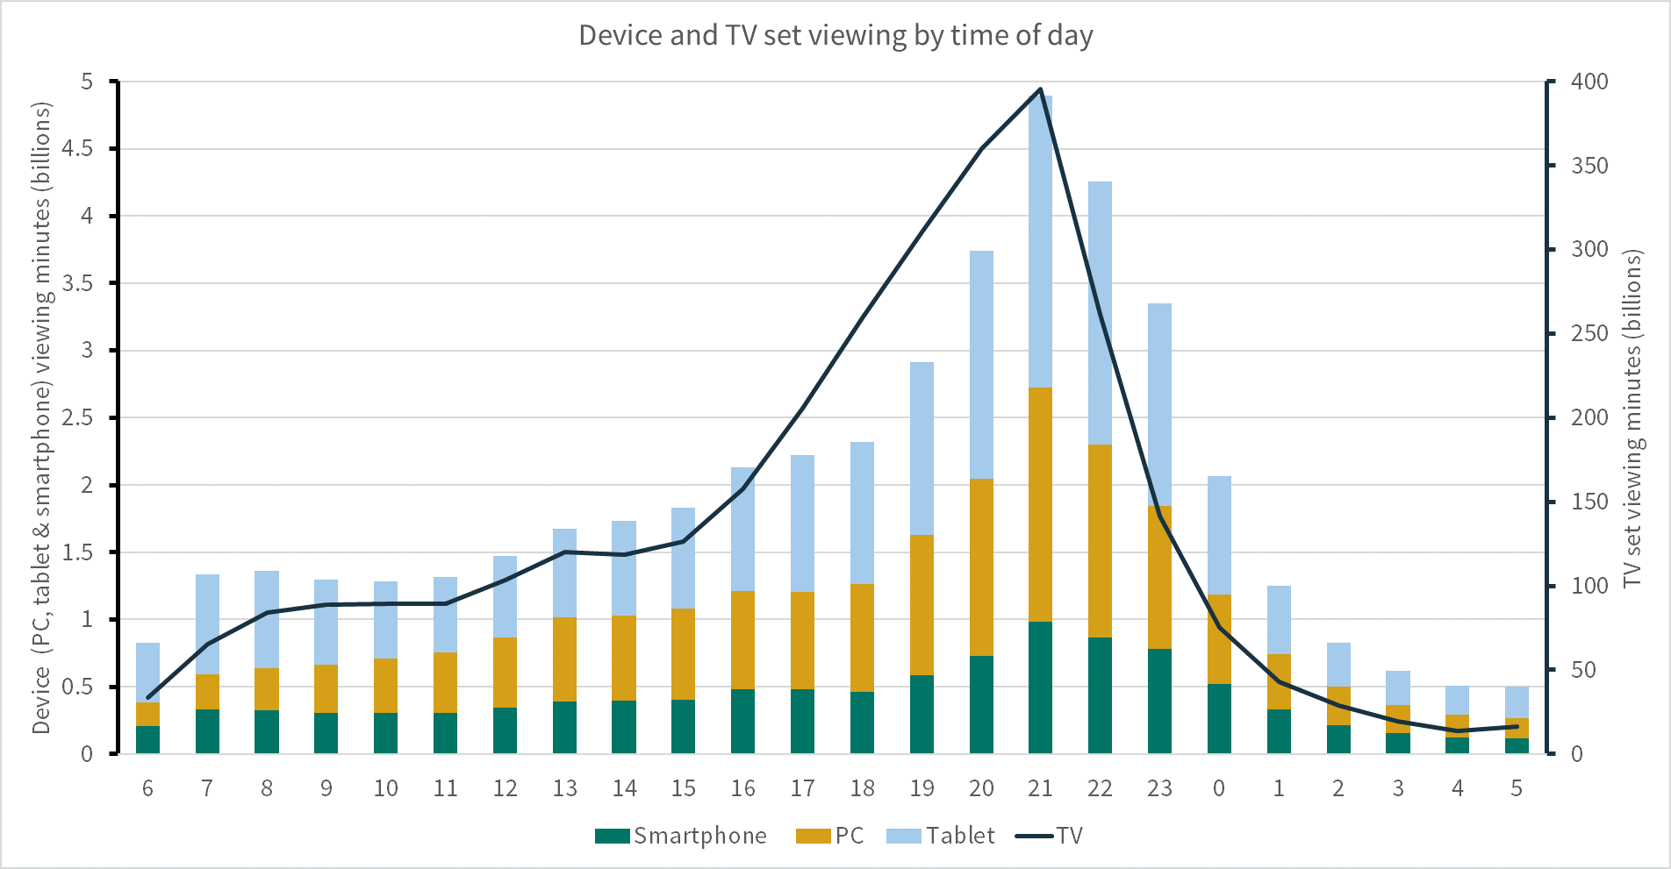
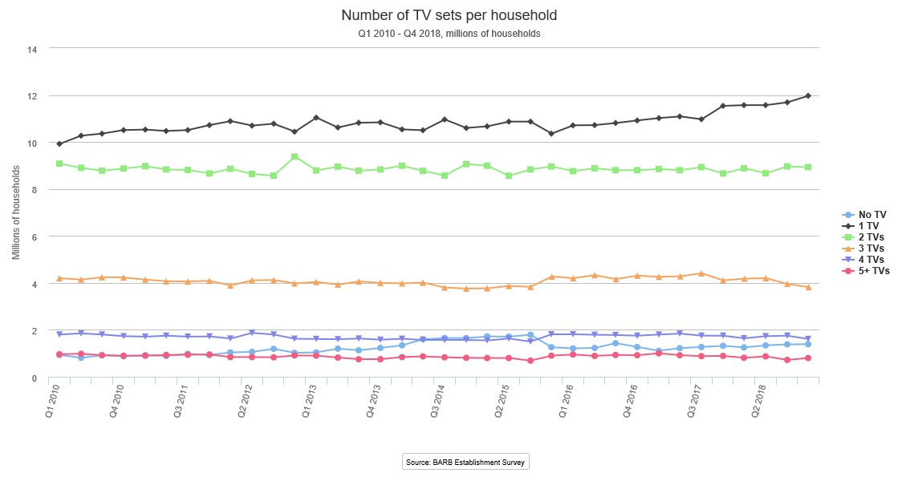
Examples of most popular products
From January – September 2018.Device and TV set viewing by time of day
Number of TV sets per household

Slide 7
Why is this product popular
BARB is popular for TV industries for them to get an understanding of when people watch TV and how they watch it etc. This is useful so that the companies know when to show certain shows, and when to show certain adverts.

Slide 8
The end. thank you.
☺

